Slide 1


Dept of CSE

Slide 2
IoT Connectivity Technologies
Connectivity technologies can be integrated with existing sensing, actuation, and processing solutions for extending connectivity to them.
Some of these solutions necessarily require integration with a minimal form of processing infrastructure, such as Wi-Fi. In contrast, others, such as Zigbee, can work in a standalone mode altogether, without the need for externalprocessing and hardware support.
Dept of CSE

Slide 3
IEEE 802.15.4
The IEEE 802.15.4 standard represents the most popular standard for low data rate wireless personal area networks (WPAN) [1]. This standard was developed to enable monitoring and control applications with lower data rate and extend the operational life for uses with low-power consumption.
This standard uses only the first two layers—physical and data link—for operation along with two new layers above it:
logical link control (LLC) and
2) service-specific convergence sublayer (SSCS)
Dept of CSE

Slide 4
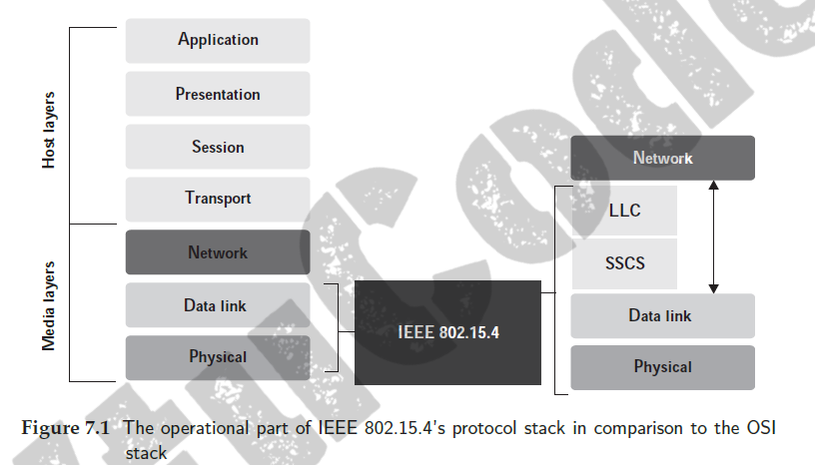
Dept of CSE

Slide 5
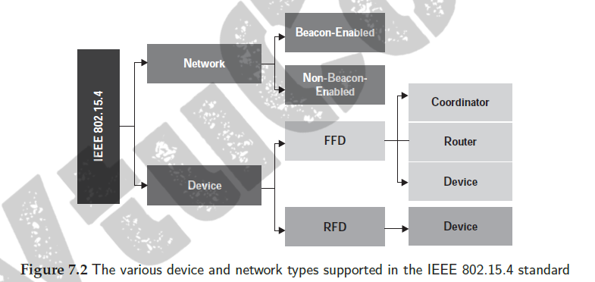
The IEEE 802.15.4 standard supports two types of devices:
reduced function device (RFD) and
2) full-function devices (FFD). FFDs can talk to all types of devices
and support full protocol stacks
Dept of CSE

Slide 6
The IEEE 802.15.4 standard supports two network types:
1) Beacon-enabled networks and
2) non-beacon-enabled networks.
The periodic transmission of beacon messages characterizes beacon-enabled networks. Here, the data frames sent via slotted CSMA/CA with a super frame structure managed by a personal area network
(PAN) coordinator
Dept of CSE
In contrast, for non-beacon-enabled networks, unslotted CSMA/CA (contentionbased)
is used for transmission of data frames, and beacons are used only for link layer discovery

Slide 7
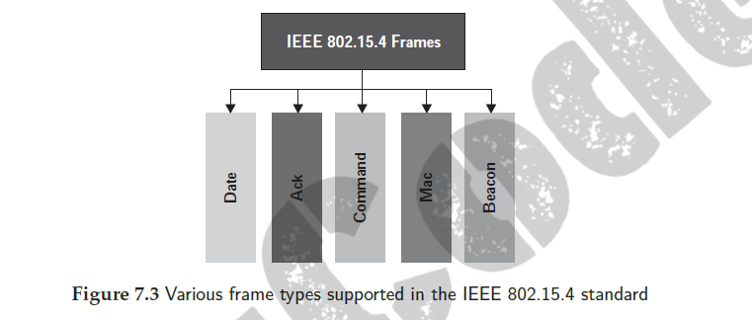
Dept of CSE

Slide 8
Zigbee
The Zigbee radio communication is designed for enabling wireless personal area
networks (WPANs).
It uses the IEEE 802.15.4 standard for defining its physical and medium access control (layers 1 and 2 of the OSI stack). Zigbee finds common usage in sensor and control networks [4].
Dept of CSE
Zigbee supports various network configurations such as master-to-master
communication or master-to-slave communication

Slide 9
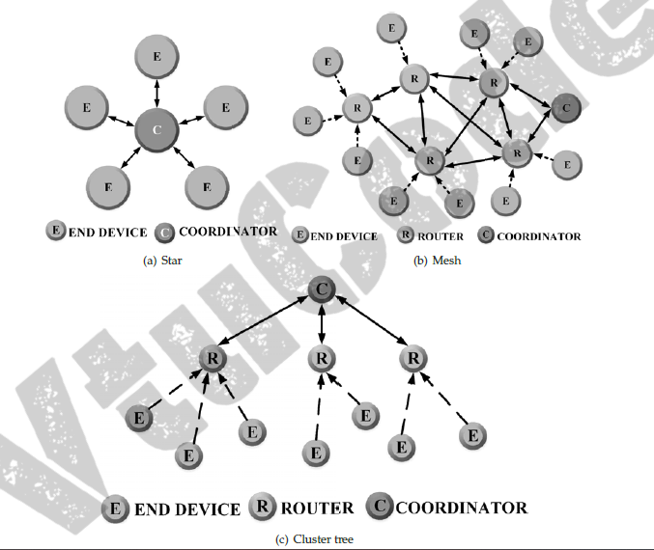
Zigbee
Dept of CSE

Slide 10
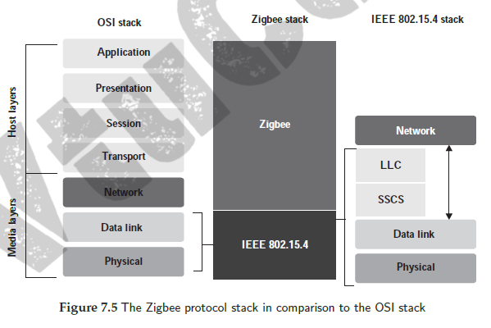
Zigbee
Dept of CSE

Slide 11
Zigbee
Physical Layer: This layer is tasked with transmitting and receiving signals, and
performing modulation and demodulation operations on them, respectively.
MAC Layer: This layer ensures channel access and reliability of data
transmission. CSMA-CA is used for channel access and intra-channel
interference avoidance.
Network Layer: This layer handles operations such as setting up the network,
connecting and disconnecting the devices, configuring the devices, and routing
Application Support Sub-Layer: This layer handles the interfacing services,
control services, bridge between network and other layers, and enables the
necessary services to interface with the lower layers for Zigbee device object
(ZDO) and Zigbee application objects (ZAO).
Application Framework: Two types of data services are provided by the
application framework: provision of a key-value pair and generation of generic
messages
Dept of CSE

Slide 12
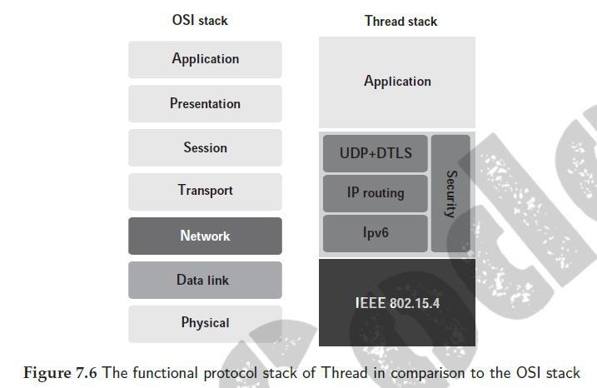
Thread
Thread is built upon the IEEE 802.15.4 radio standard; it is used for extremely
low power consumption and low latency deployments . Unlike Zigbee, Thread can extend direct Internet connectivity to the devices it is connected with
Dept of CSE

Slide 13
Thread removes the need for a mobile phone or a proprietary gateway to be in the range of devices for accessing the Internet.
It is specially designed for IoT with the need for interoperability, security, power, and architecture addressed in a single radio platform
Dept of CSE
Thread is built on open standards to achieve a low-power wireless mesh networking protocol with universal Internet Protocol (IP) support

Slide 14
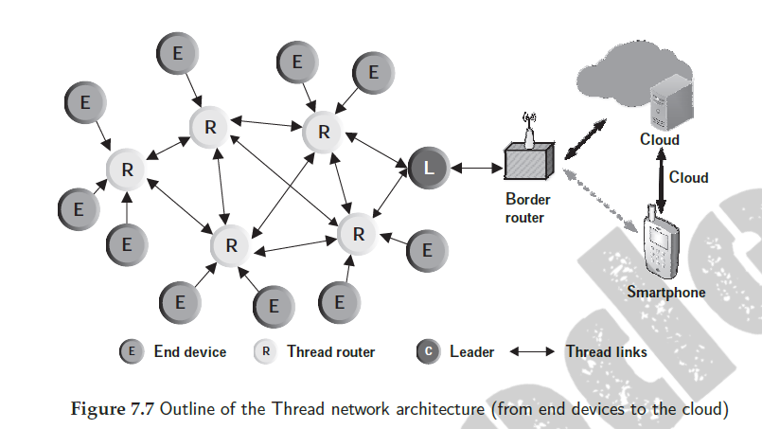
Dept of CSE

Slide 15
ISA100.11A-International Society of Automation
It uses the IEEE 802.15.4 standard as a base for building its protocol
An ISA100.11A wireless network utilizes the 2.4 GHz frequency band for
communication, similar to Wi-Fi and Bluetooth. To avoid interference over wireless
channels in the same band, it uses frequency hopping spread spectrum (FHSS) over a
total of 16 channels.
Dept of CSE
The ISA100.11A architecture consists of
the following:
field device and
Backbone devices
The ISA100.11A architecture
provides support for mesh, star, and star–mesh topologies.

Slide 16
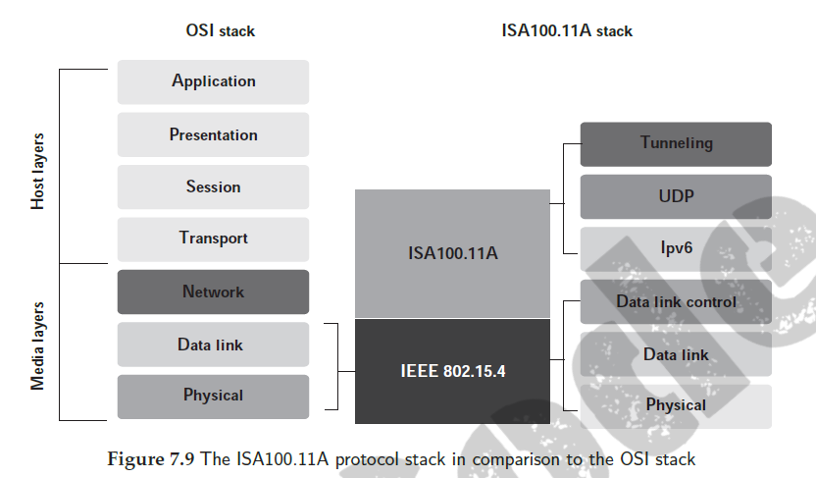
The average ISA100.11A protocol stack consists of five different layers:
1) Application layer, 2) transport layer, 3) network layer, 4) data link layer, and
5) physical layer
Dept of CSE

Slide 17
WirelessHART
WirelessHART can be considered as the wireless evolution of the highway addressable remote transducer (HART) protocol
WirelessHART can communicate with a central control system in any of the two ways:
1) Direct and
2) indirect.
Direct communication is achieved when the devices transmit data directly
to the gateway in a clear LOS (typically 250 m).
Indirect communication is achieved
between devices in a mesh and a gateway when messages jump from device to
device until it reaches the gateway.
Dept of CSE

Slide 18
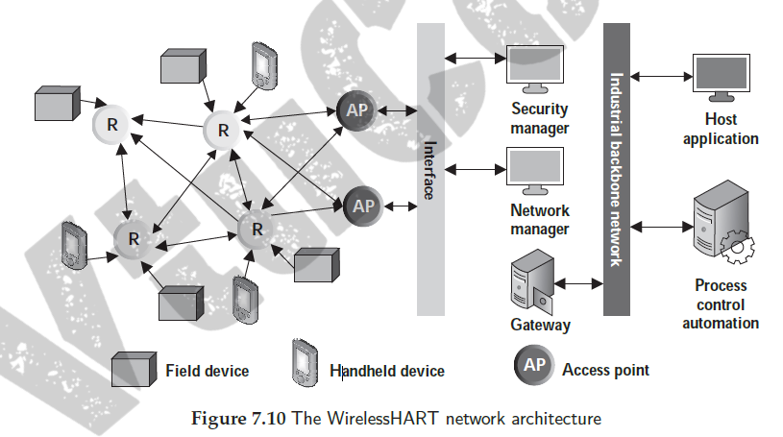
Dept of CSE

Slide 19
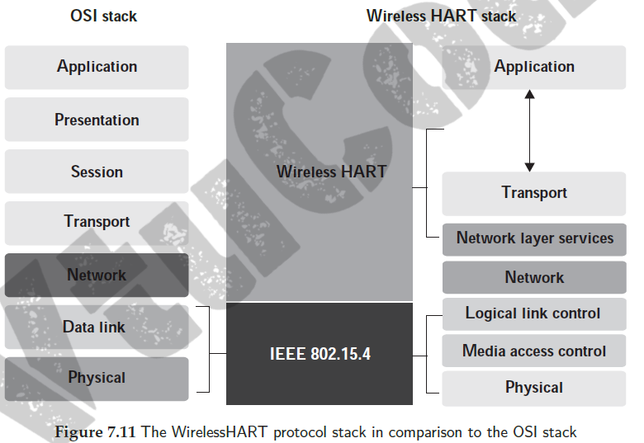
Dept of CSE

Slide 20
RFID
RFID stands for radio frequency identification. This technology uses tags and readers for communication
RFID tags have data encoded onto them digitally. The RFID readers can read the values encoded in these tags without physically touching them
The automatic identification and data capture (AIDC) technology can be
considered as the precursor of RFID
Dept of CSE
Typically, RFID systems are made
up of three components:
RFID tag or smart label,
RFID reader, and
antenna

Slide 21
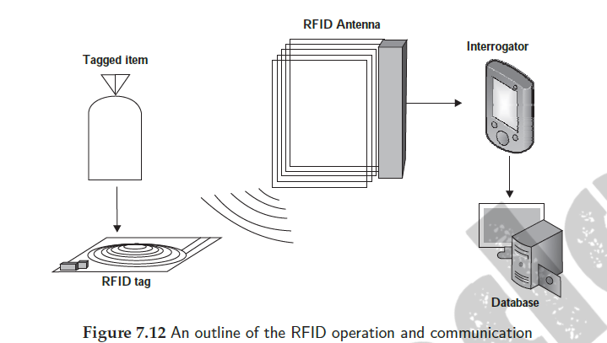
Dept of CSE

Slide 22
NFC -Near field communication
Developed by Philips and Sony as a short-range wireless connectivity standard, enabling peer-to-peer (P2P) data exchange network. Communication between NFC devices is achieved by the principle of magnetic induction, whenever the devices are brought close to one another
The communication between compatible devices requires a pair of transmitting and receiving devices
Dept of CSE
NFC devices can be grouped into two types:
passive NFC and
2) active NFC

Slide 23
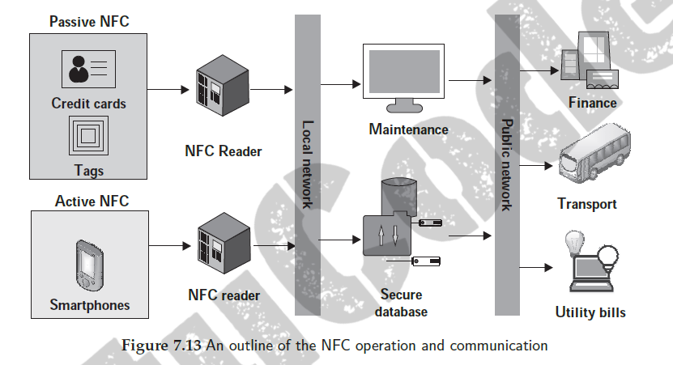
Dept of CSE

Slide 24
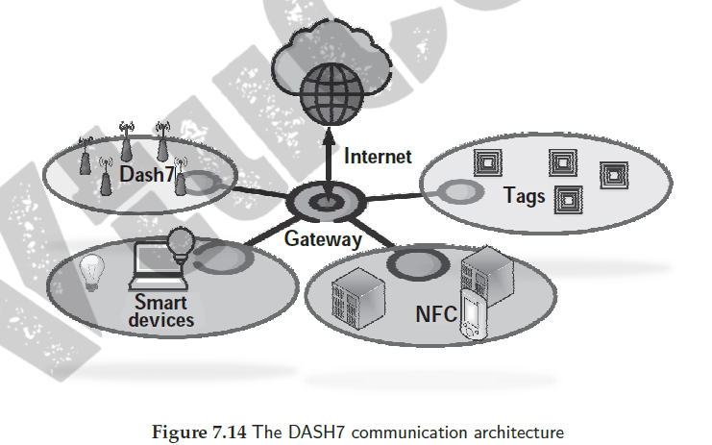
DASH7-Dynamic Adaptive Streaming over HTTP
The DASH7 protocol is based on an active RFID standard . It operates in the 433
MHz frequency band and is being rapidly accepted in agriculture, vehicles, mobiles,
and other consumer electronics-related applications
Dept of CSE

Slide 25
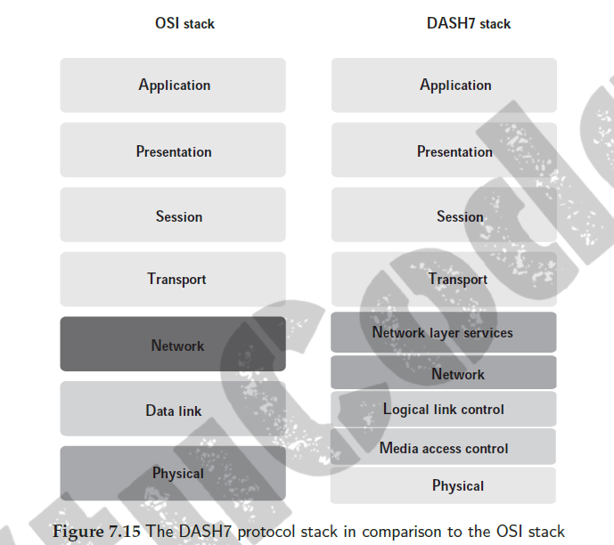
Dept of CSE

Slide 26
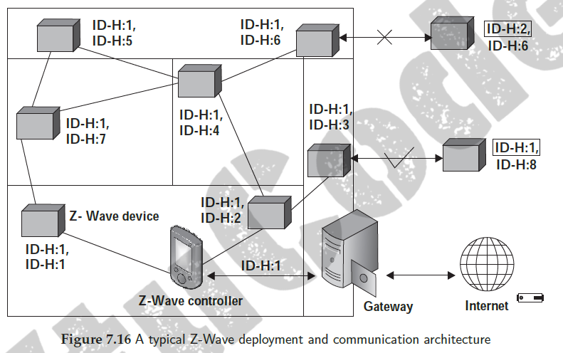
Z-Wave
Z-Wave is an economical and less complicated alternative to Zigbee. It was developed by Zensys, mainly for home automation solutions
It boasts of a power consumption much lower than Wi-Fi, but with ranges greater than Bluetooth. This feature makes Z-Wave significantly useful for home IoT use by enabling inter-device communication between Z-wave integrated sensors, locks, home power distribution systems, appliances, and heating systems
Dept of CSE

Slide 27
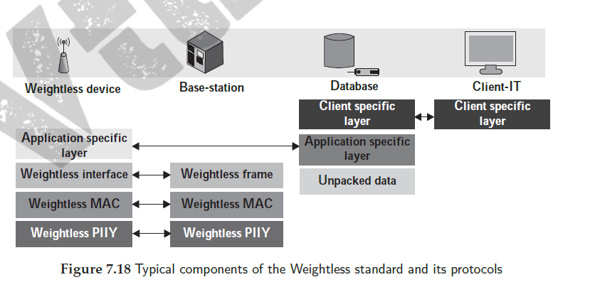
Weightless
Weightless is yet another emerging open standard for enabling networked
communication in IoT; it is especially useful for low-power wide area networks
Dept of CSE

Slide 28
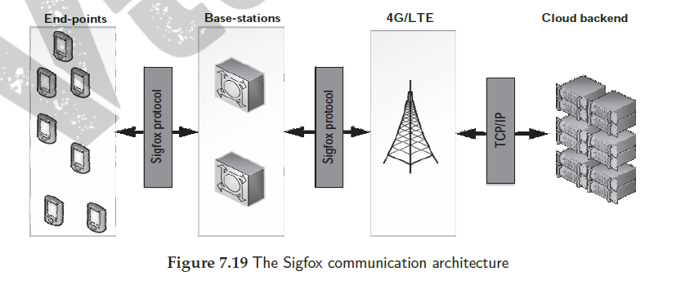
Sigfox
Sigfox is a low-power connectivity solution, which was developed for various
businesses such as building automation and security, smart metering, agriculture,
and others
Dept of CSE

Slide 29
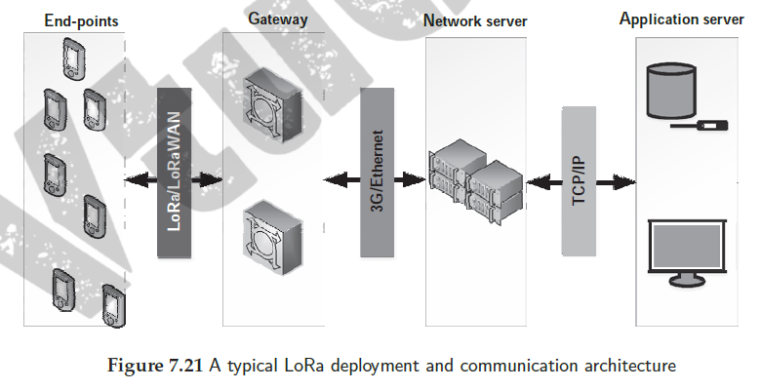
LoRa
LoRa or long range is a patented wireless technology for communication developed
by Cycleo of Grenoble, France for cellular-type communications aimed at providing
connectivity to M2M and IoT solutions
Dept of CSE

Slide 30
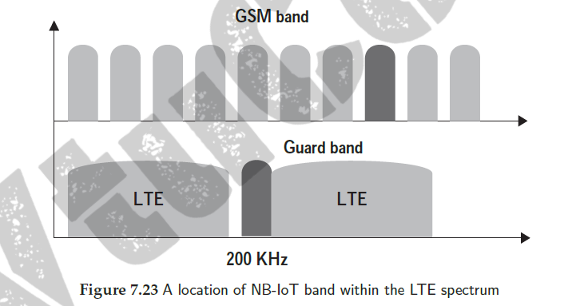
NB-IoT
NB-IoT or narrowband IoT is an initiative by the Third Generation Partnership
Project (3GPP) to develop a cellular standard, which can coexist with cellular systems
(2G/3G/4G), be highly interoperable and that too using minimum power
NB-IoT communication can either make use
of the available 200-kHz GSM (global system for mobile communications) bands or
be allocated resource blocks on the guard bands by LTE(Long-Term Evolution) base stations
Dept of CSE

Slide 31
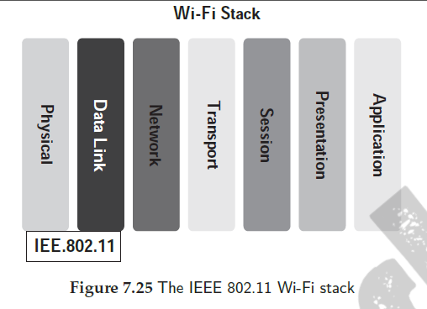
Wi-Fi
Wi-Fi or WiFi is technically referred to by its standard, IEEE 802.11, and is a wireless
technology for wireless local area networking of nodes and devices built upon similar
standards (Figure 7.25)
Dept of CSE

Slide 32
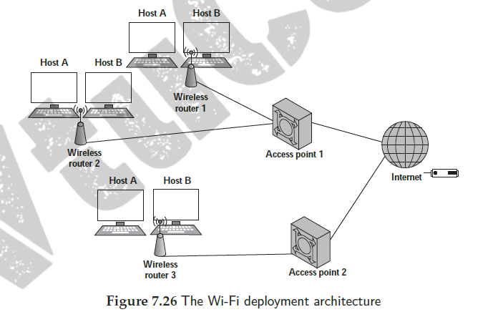
Dept of CSE

Slide 33
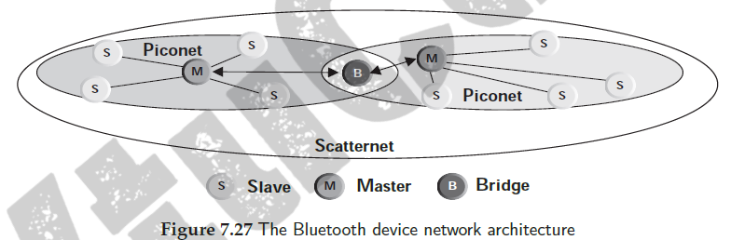
Bluetooth
Bluetooth is defined by the IEEE 802.15.1 standard and is a short-range wireless communication technology operating at low power to enable communication among two or more Bluetooth-enabled devices
Dept of CSE

Slide 34
Dept of CSE

